Slide 1
Self-driving Car

Slide 2
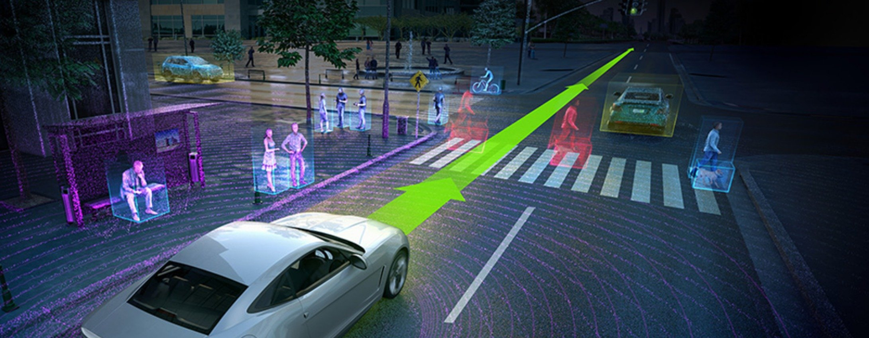
Self-driving Car

Slide 3
Self-driving Car

Slide 4
Self-driving Car

Slide 5
Self-driving Car

Slide 6
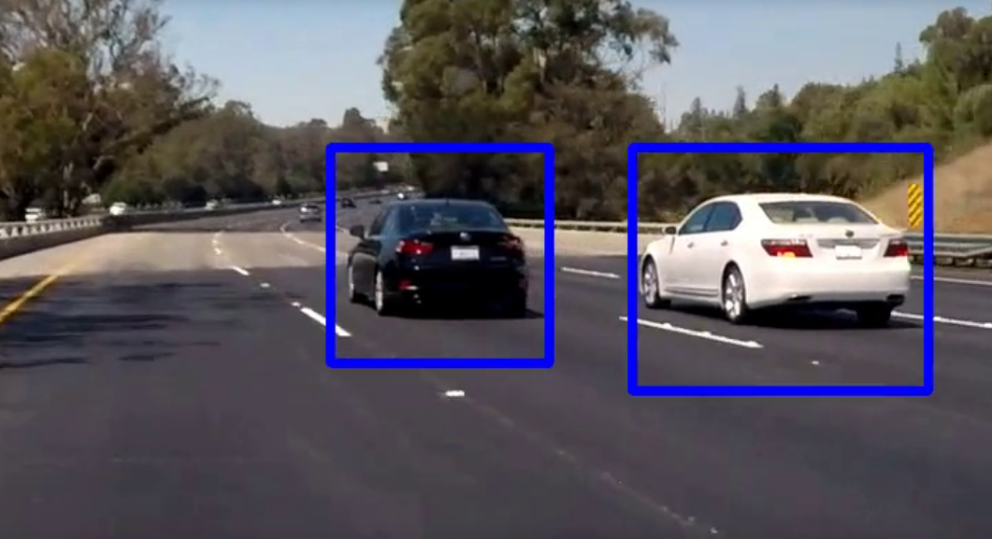
Self-driving Car
Car detection

Slide 7
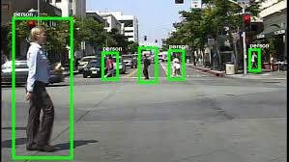
Self-driving Car
Car detection
Pedestrian detection

Slide 8
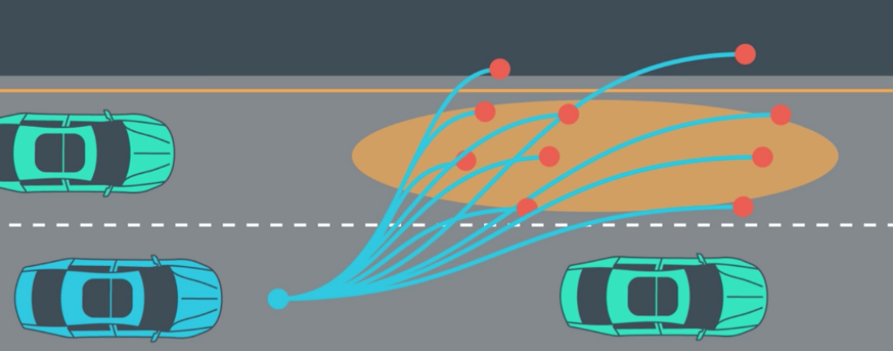
Self-driving Car
Car detection
Motion planning
Pedestrian detection

Slide 9
Self-driving Car
Car detection
Motion planning
Pedestrian detection
Cameras, Radar
GPS, Maps

Slide 10
Self-driving Car
Car detection
Motion planning
Trajectory prediction
Pedestrian detection
Cameras, Radar
GPS, Maps
Trajectory prediction

Slide 11
Self-driving Car
Car detection
Motion planning
Trajectory prediction
Pedestrian detection
Cameras, Radar
GPS, Maps
Trajectory prediction
Lane, Light,
Object detection

Slide 12
Self-driving Car
Car detection
Motion planning
Trajectory prediction
Pedestrian detection
Cameras, Radar
GPS, Maps
Trajectory prediction
Steer, Accelerate, Brake
Lane, Light,
Object detection

Slide 13
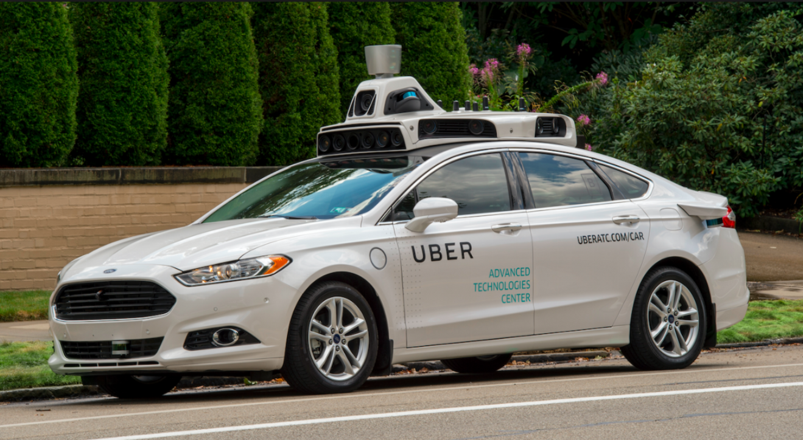

Slide 14
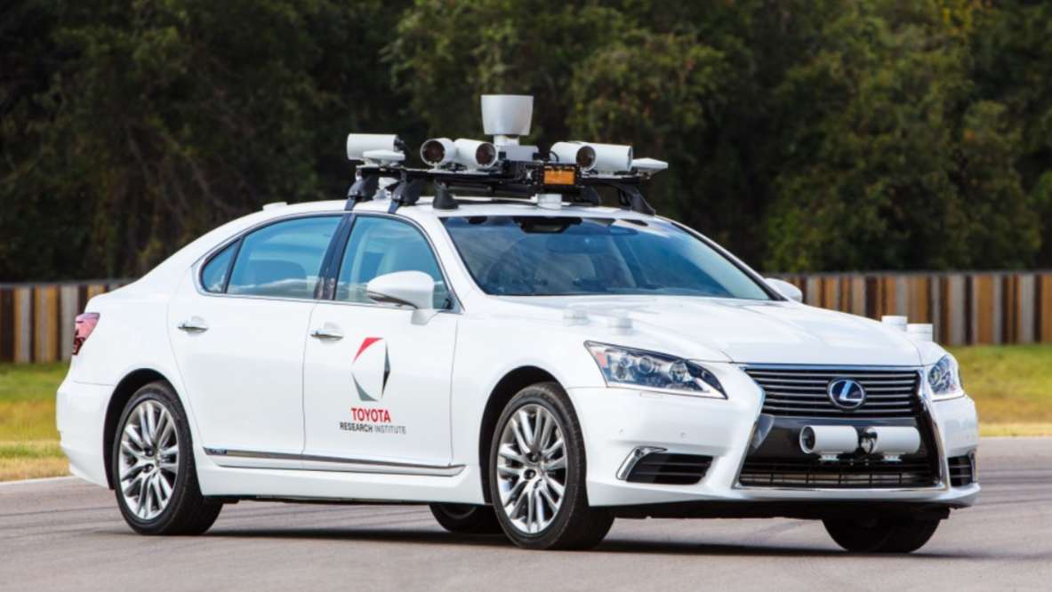

Slide 15
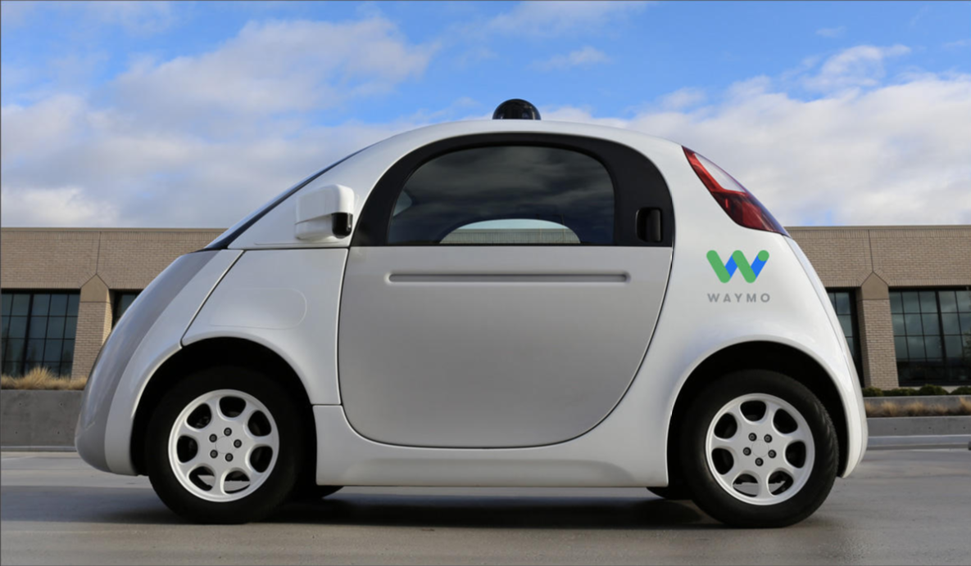

Slide 16
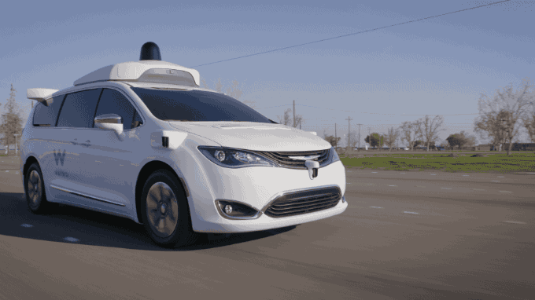

Slide 17
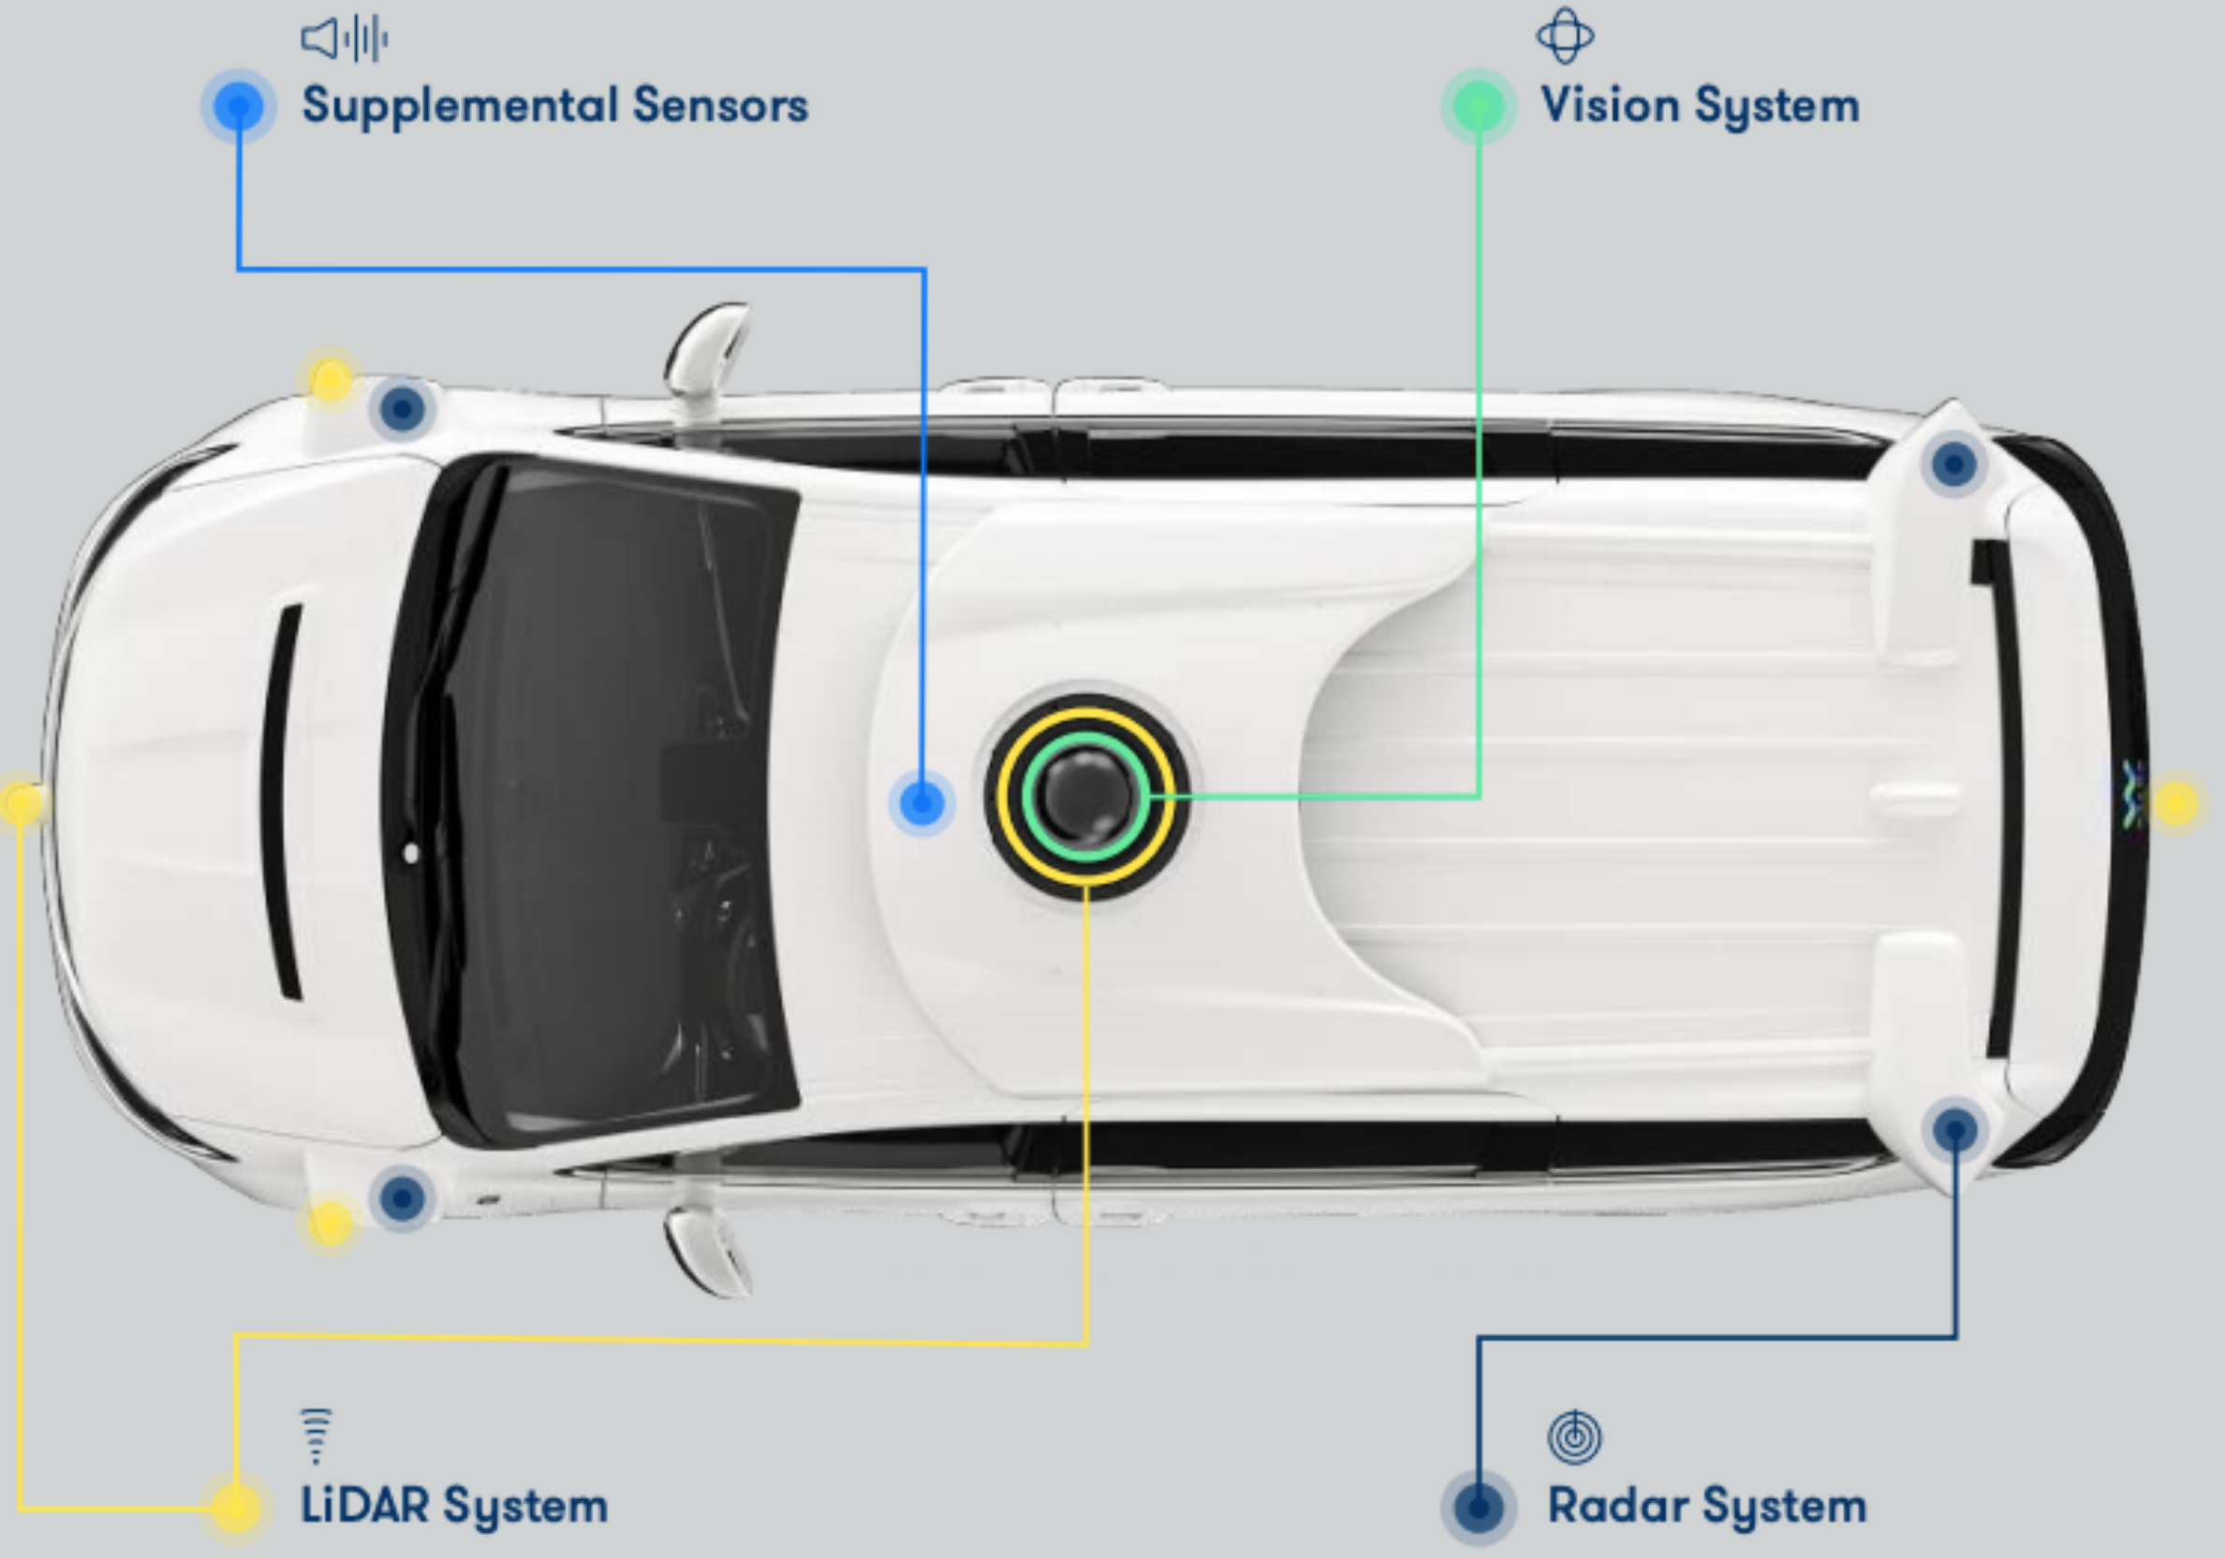

Slide 18
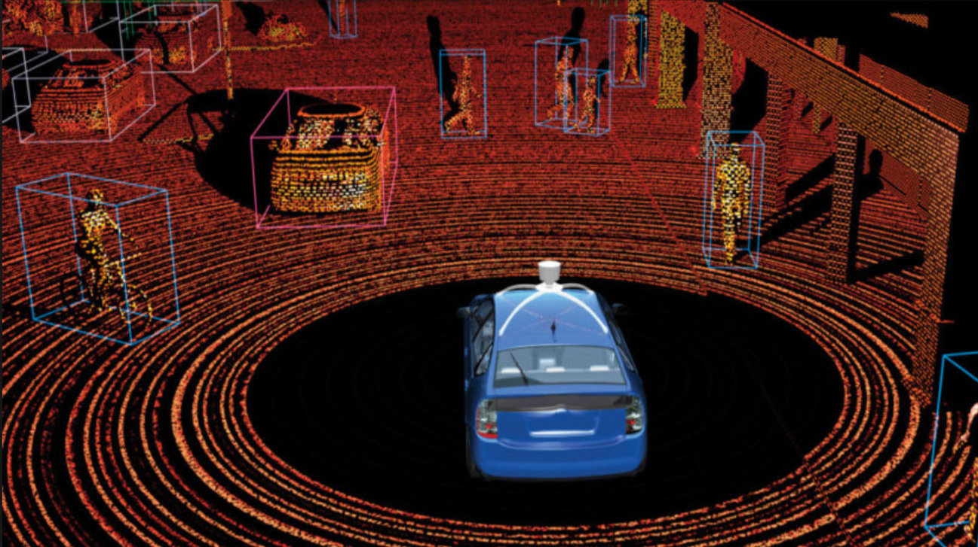

Slide 19


Slide 20
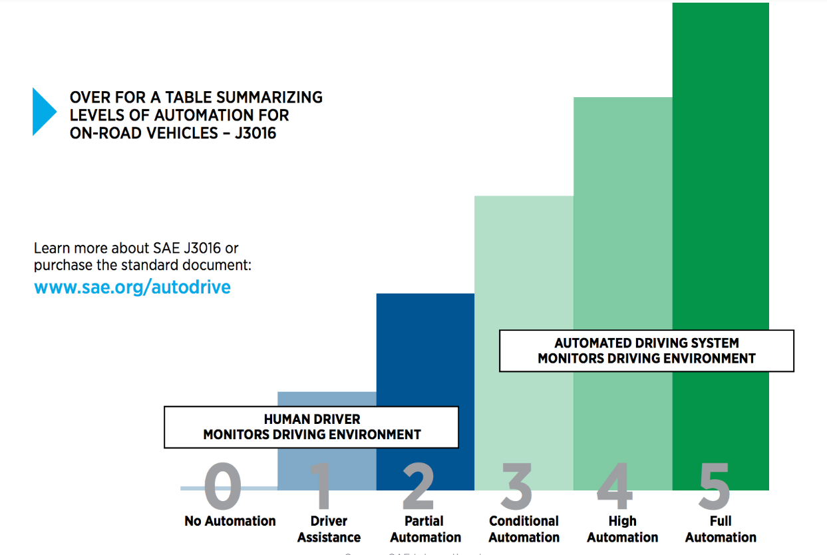

Slide 21
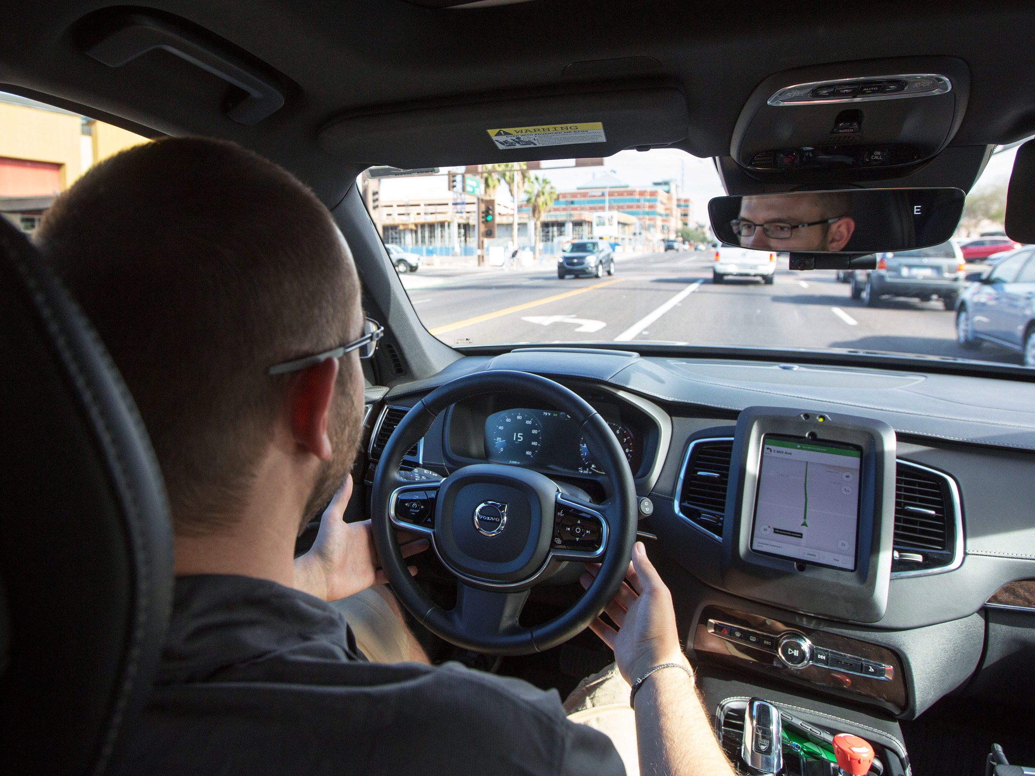
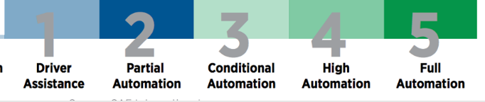

Slide 22
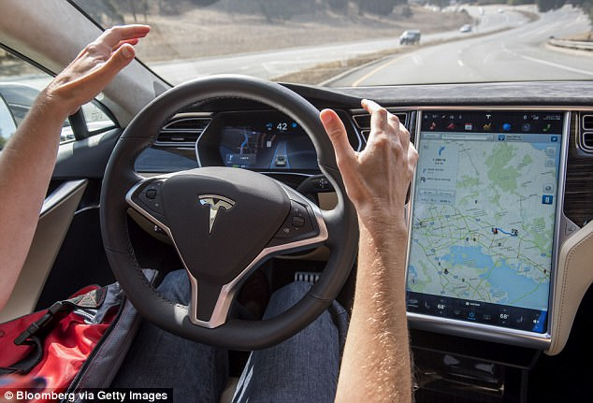

Slide 23
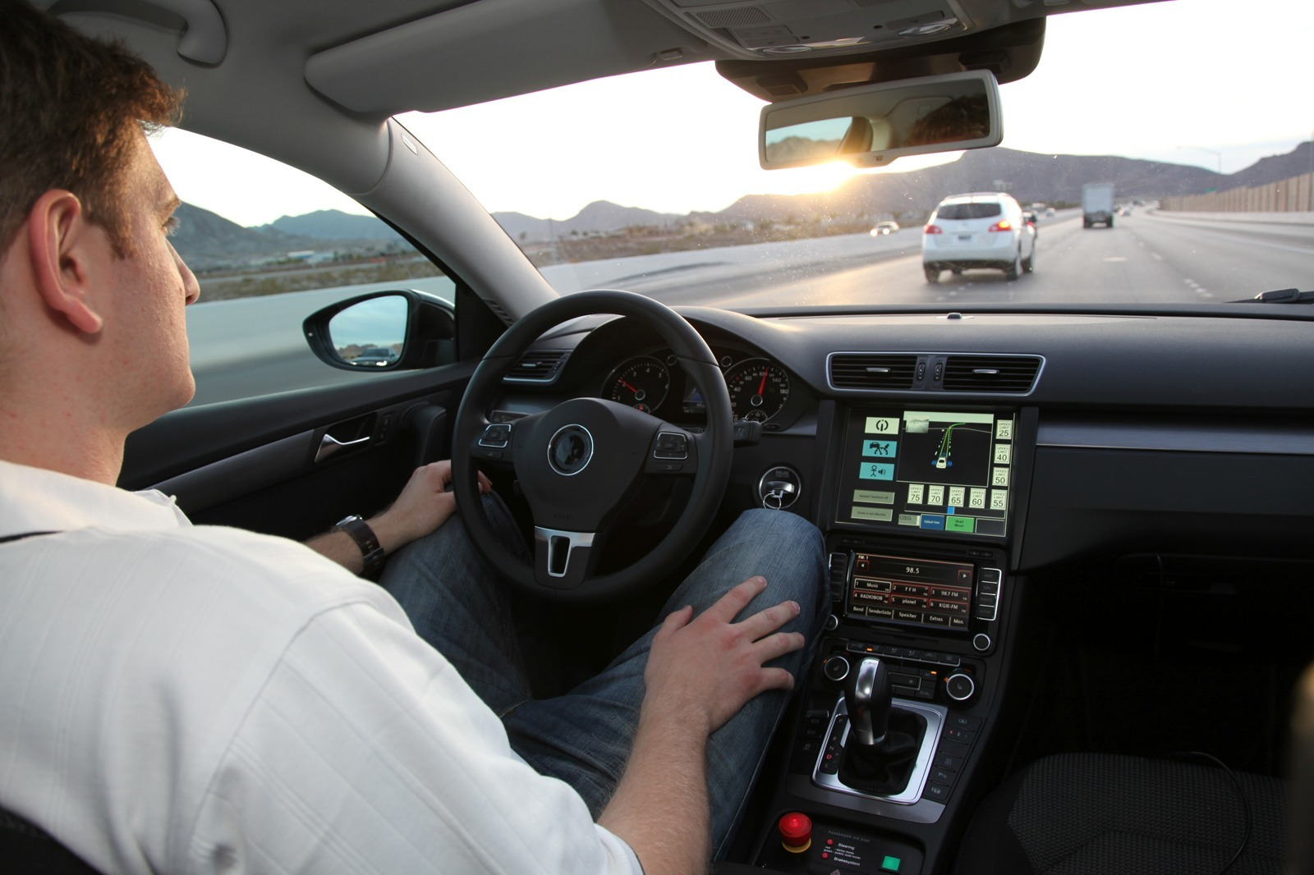

Slide 24
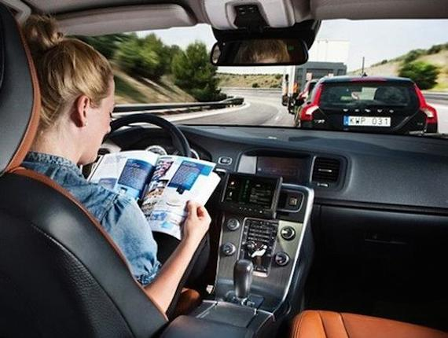

Slide 25
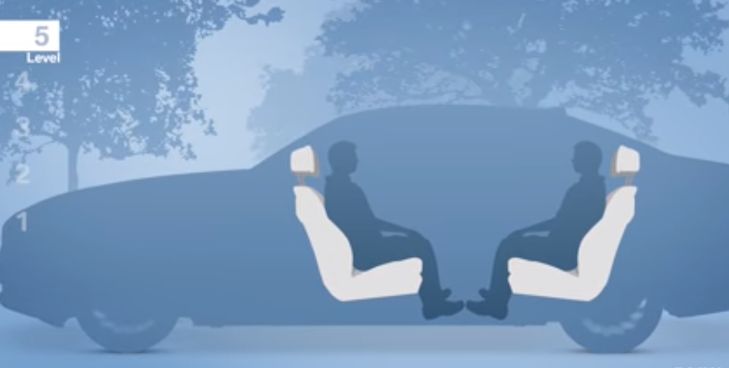

Slide 26
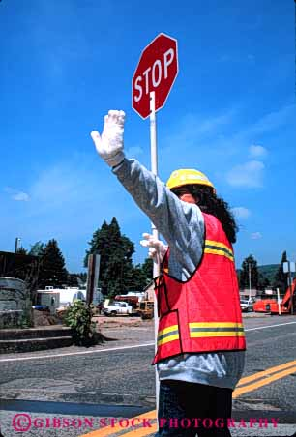

Slide 27


Slide 28


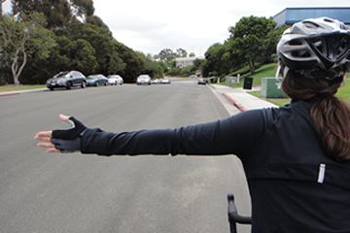

Slide 29
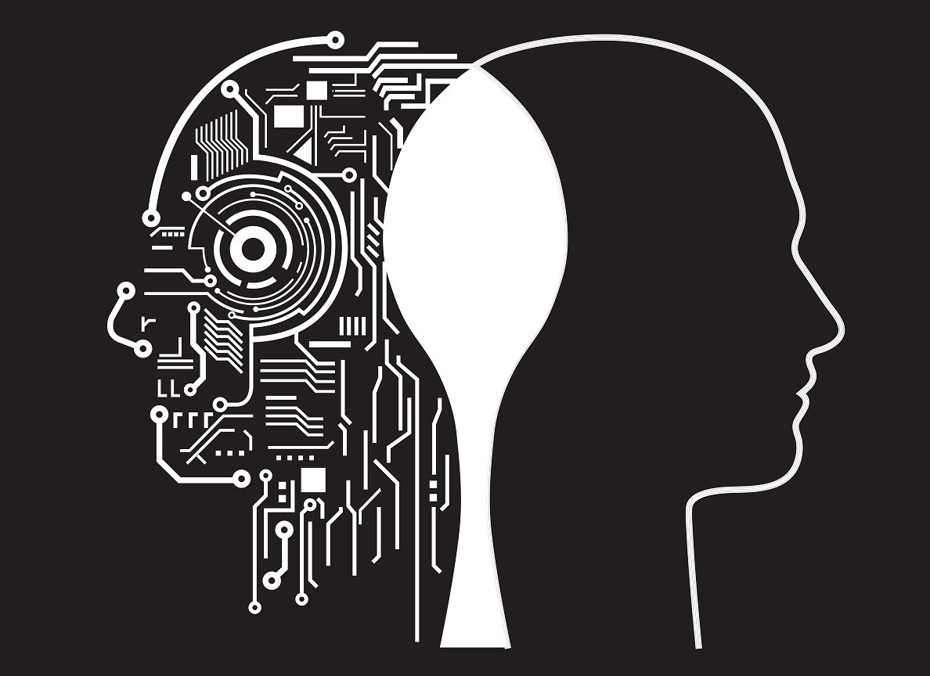
Machine vs. Man

Slide 30
Main advantages of Artificial Intelligence over Natural Intelligence are:
Incredible speed
Continuous operation
Less biased
Accuracy

Slide 31
Main advantages of Natural Intelligence over Artificial Intelligence are:
Generalizing knowledge
Multi-tasking
Differentiating subtleties of context
Complex movements

Slide 32
AI performs poorly when:
Trying to learn complex concepts from a small amount of data

Slide 33
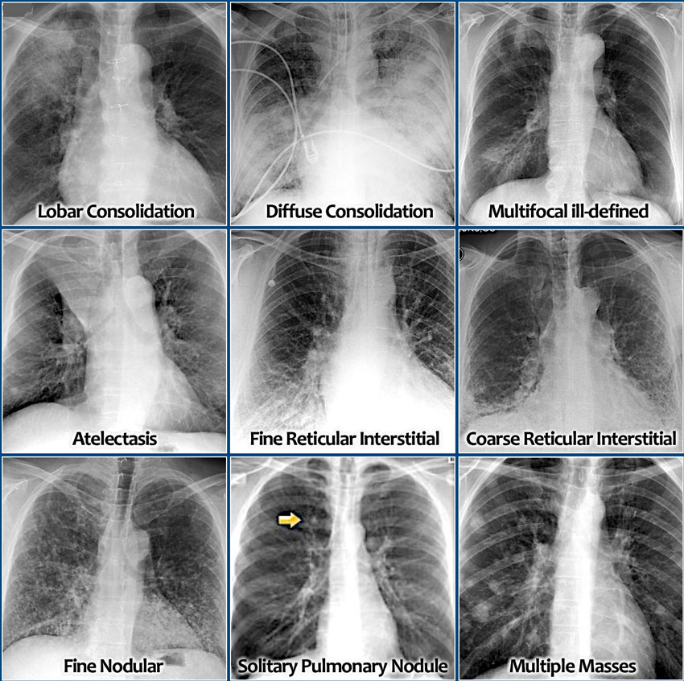

Slide 34
AI performs poorly when:
Performing a task on new types of data

Slide 35
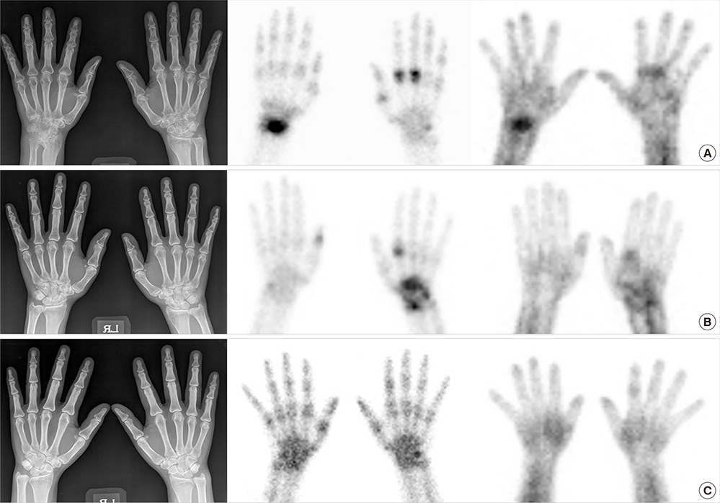

Slide 36
